Slide 1
Fast Reactor Designing Study for Proliferation Resistance and Physical Protection Enhancement
Pedro Junior Vicente Valdez
SAGARA-Laboratory
Laboratory of Advance Nuclear Energy
Tokyo Institute of Technology Summer Program
Notes:
Hi Mi name is Pedro and I will be talking to you about “Fast reactor … enhancement”. This research was undertaken at the SAGARA laboratory in the Laboratory of Advance Nuclear Energy as part of the Tokyo Tech Summer Program.

Slide 2
Research Plan and Objectives
MCNP4 particle transport code
Critical mass and heat content calculations
Neutron transport calculations
Nuclear material attractiveness methodology
Research on fast spectrum reactor designing for Minor Actinides (MA) transmutation and for High Proliferation Resistance.
Neutronics analysis of a Fast Spectrum Reactor core design:
Reactivity and burnup calculation by the combination of a 2-D deterministic code, SLAROM-JOINT-CITATION, for full scale fast spectrum core designing and performance evaluation
Learning of the Plutonium (Pu) fuel cycle in Japan. This will include the research of the underlying physics of the Pu fuel cycle.
Notes:
As stated in the initial research plan, there were several objectives and goals to be accomplished and they can be resumed in four objectives. First is learning and applying MCNP4 particle transport code for critical mass and heat content calculations, neutron transport calculations and nuclear material attractiveness methodology. Secondly is carrying research on FSR designing for MA transmutation and for high proliferation resistance. Thirdly is the neutronics analysis of a FSR core design. This was done by applying a combination of a 2-D determinist code, SLAROM-JOIN-CITATION for reactivity and burnup calculations. And lastly was to learn about the Pu fuel cycle in Japan including understanding the underlying physics of the Pu fuel cycle. As we will see know all of this objectives were accomplished.
(1:20)

Slide 3
Important Definitions:
Proliferation Resistance
is that characteristic of an NES that impedes the diversion or undeclared production of nuclear material or misuse of technology by the Host State seeking to acquire nuclear weapons or other nuclear explosive devices.
Physical Protection
is that characteristic of an NES that impedes the theft of materials suitable for nuclear explosives or radiation dispersal devices (RDDs) and the sabotage of facilities and transportation by sub-national entities and other non-Host State adversaries.
Notes:
First, some important definitions to remember are proliferation resistance and physical protection. Proliferation resistance is that characteristic of an NES that impedes the diversion or undeclared production of nuclear material or misuse of technology by the Host State seeking to acquire nuclear weapons or other nuclear explosive devices. A host state is an actor non-nuclear weapon state assumed to have physical control over the facility and materials being evaluated.
The second definition is Physical Protection which is the characteristic of an NES that impedes the theft of materials suitable for nuclear explosives or radiation dispersal devices (RDDs) and the sabotage of facilities and transportation by sub-national entities and other non-Host State adversaries.
(1)

Slide 4
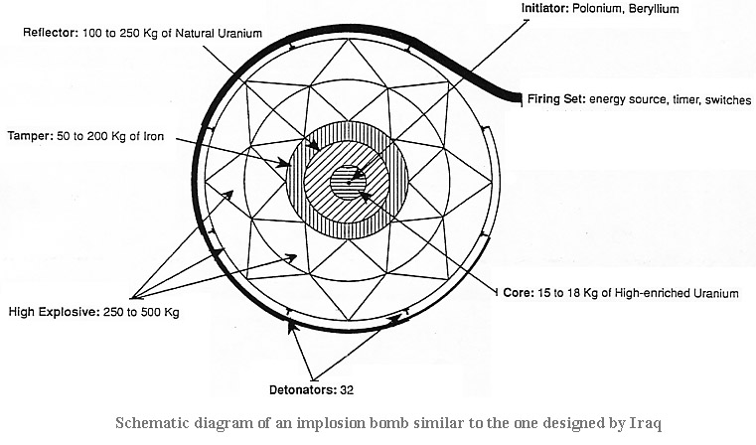
MCNP4 – Particle Transport Code
Evaluating Bare Critical Mass, Attractiveness and Safety
Notes:
The first objective was learning the use of a popular Monte Carlo n-particle transport code. This code can be use for neutron, photon, electron, or coupled neutron/photon/electron transport with applications in radiation shielding protection and dosimetry,, nuclear criticality safety, fission and fusion reactor design, among others.
As stated in the title, using this code, we evaluate the bare critical mass for different elements and isotopes and it’s attractiveness and safety.

Slide 5
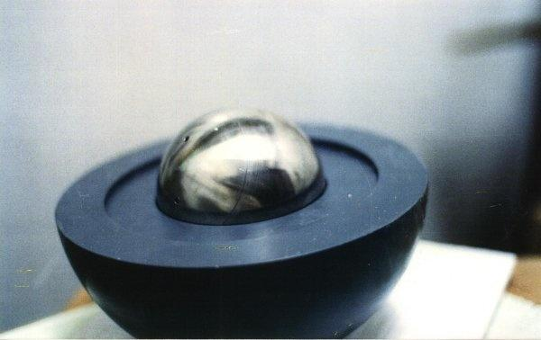
Bare Critical Mass
Notes:
The critical mass is the smallest amount of fissile material needed for a sustained nuclear chain reaction. The critical mass of a fissionable material depends upon its nuclear properties (specifically, the nuclear fission cross-section), density, shape, enrichment, purity, temperature, and its surroundings. This is important for nuclear weapon design as it is almost equivalent to the mass needed to successfully construct an NED. The shape with minimal critical mass and the smallest physical dimensions is a sphere and therefore is the starting point for this measurements and regulations.
(1)

Slide 6
Exercise 1: BCM of U-235 and Pu-239
Isotope | radius (cm) | k-eff
U-235 | 8.28 | 1.00054
Pu-239 | 4.96 | 1.00018
BCM U-235 = 45.29 kg
BCM Pu-239 = 10.12 kg
U-235 or
Pu-239 metal sphere
r cm
Notes:
The first calculation was simple and was to find the BCM of U-235 and Pu-239. Criticality is measure by what is known as the multiplication factor, k. K below 1 means subcriticality, k = 1 means criticality meaning self-sustain chain reaction and K>1 means supercriticality meaning that neutron population increases exponentially. An NED works by achieving supercriticality rapidly. It was found that for U-235 the quantity needed was 45.29 kg and for Pu-239 was 10.12 kg. The difference comes from the higher density and neutron cross section that Pu possesses. This means that if a terrorist group we’re to have two pieces of Pu-239 weighting around 5 kg each they would have the fissile material necessary to make an NED.
(1)

Slide 7
Exercise 2: BCM of different U-enrichment
U metal sphere
Enrichment (wt..%) | BCM (kg) | k-eff | radius (cm)
0.72 | - | 0.43197 | -
5 | - | 0.94089 | -
10 | 4448 | 1.00092 | 38.2
20 | 815 | 0.99948 | 21.7
50 | 154 | 0.99907 | 12.45
100 | 46 | 1.00042 | 8.3
Mass density:
U-metal 19.05 g/cc
r cm
Notes:
The next exercise was to calculate the BCM with different U-enrichment. It may be difficult for host and non-host states to acquire 100% purity of u-235 and pu-239 therefore they rely in enrichment. Enrichment means elevating the composition of a specific isotope relative to the others. In this case means elevating the quantity of U-235. By logic it is expected for the bare critical mass to decrease as enrichment increases. The doe considers all uranium with 20% or more enrichment as HEU which has higher restrictions due to it’s possible but improbable use in NED. Notice that as enrichment is decrease the BCM increasing exponentially to infinity. (1)

Slide 8
Exercise 3: BCM of different material forms of Uranium
U-met
/UO2/(U,Zr)O2 sphere
Nuclide: U-235
Material form: U-Metal, UO2, (U,Zr)O2
Mass density: U-metal 19.05 g/cc, UO2 10.96gcc,
(U,Zr)O2 6.0g/cc, U:Zr=1:3 in atom
BCM U-Metal = 45.63 kg-U, 45.63 kg-total
BCM UO2 = 92.44 kg-U, 104.87 kg-total
BCM (U,Zr)O2 = 318.08 kg-U, 854.82 kg-total
r cm
Notes:
The next calculation was calculating the BCM mass of Uranium in two different material forms. In Uranium Oxide and Uranium Zirconium Oxide. Uranium oxide is commonly use as nuclear fuel in nuclear reactors in the form of rods. This showed that the mass of UO2 required to achieve criticality was 92.44 kg-U only around 18 kg more. (1)

Slide 9
Exercise 4: CM with reflector
Pu-239
Material : Pu239-Metal with reflector
Mass density: Pu-metal 19.80g/cc
Reflector : U-metal 19.05g/cc, Be-metal 1.85g/cc,
Graphite 2.10g/cc
CM Bare Pu = 10.12 kg-Pu, 10.12 kg-total
CM Pu/U= 5.39 kg-Pu, 58.76 kg-total
CM Pu/Be= 4.92 kg-Pu, 9.92 kg-total
CM Pu/C= 5.72 kg-Pu, 11.74 kg-total
 | Pu | Pu/U | Pu/Be | Pu/C
Radius | 4.96 | 4.02/9.02 | 3.9/8.9 | 4.1/9.1
Capture CS | - | 2.683 | 0.008603 | 0.0035
Notes:
As I mentioned it is difficult to come by 100% pure U-235 and Pu-239 as it’s only artificially produced therefore the use of a Reflector is employed. A reflector is a material that reflects neutrons that try to escape back into the core by elastic scattering. Several materials can be used as reflectors and their performance depends on their scattering cross section. In this calculation we tried to use natural uranium, beryllium and graphite as reflectors to calculate the required CM. As seen in the result, for NED purposes it is better to use Beryllium or graphite as it requires less Plutonium for the achievement of criticality. Uranium, due to it’s capture cross section is less suitable as a reflector. This is because of the scattering cross section of the different materials.
(1)

Slide 10
Exercise 5: Attractiveness
Material : bare Pu-Metal, Pu-239, Pu238
Mass density: Pu-metal 15.80g/cc
with delta-phase
Rossi-alpha:
Isotope | Decay heat (W/kg) | SN (n/g/s)
²³⁸Pu | 567 | 2660
²³⁹Pu | 1.93 | 0.0226
²⁴⁰Pu | 7.06 | 1030
²⁴¹Pu | 3.4 | 0.0493
²⁴²Pu | 0.12 | 1720
Isotope | radius (cm) | mass (kg) | k-inf | l (abs) | alphaN | decayN | ATTR | ATTR(N)
238 | 5.96 | 14.01 | 2.81324 | 1.27E-08 | 0.96 | 1.00000 | 0.9627619 | 0
239 | 6.22 | 15.93 | 2.95061 | 1.31E-08 | 1.00 | 0.00387 | 258.4596560 | 1
240 | 9.02 | 48.57 | 2.23078 | 4.57E-08 | 0.18 | 0.04316 | 4.1926093 | 0.012543
241 | 6.58 | 18.85 | 2.90547 | 1.23E-08 | 1.04 | 0.00807 | 129.1969948 | 0.498003
242 | 11.3 | 95.50 | 1.9642 | 7.68E-08 | 0.08 | 0.00144 | 58.5002960 | 0.223449
Notes:
For Exercise number 5 we used a methodology to evaluate the attractiveness of different isotopes, in this case Plutonium. ATTR is defined as the ratio of potential explosive yield factor of fissionable materials to characteristics of technical difficulty factor in manufacturing NED. The potential explosive yield factor was defined as a power function of Rossi-alpha (the ratio of supercriticality to prompt neutron lifetime) of infinite mass fissionable materials.
Prompt neutron lifetime is the average time from a prompt neutron emission to either its absorption(fission or radiative capture) or to its escape from the system.
the technical difficulty factor is assumed as the decay heat per unit mass of the fissionable materials (DH [W/kg]) for the application of the new criteria based on decay heat. Decay heat is the heat released as a result of radioactive decay.
Rossi-alpha and decay heat are normalized by the Rossi-alpha of pure 239Pu and the decay heat of 238Pu, which is the maximum value in Pu isotopes. It can be seen from the table that Pu-238 has the highest decay heat while Pu-239 is amongst those with the lowest decay heat factors. From the MCNP output we gather the information needed including mass, k-inf and prompt neutron lifetime. Finally we obtain the normalized attractiveness. It can be seen that this methodology correctly categorizes each isotope by resulting in high attractive for Pu-239 and Pu-241 and low attractiveness of the other isotopes.
(2:10)

Slide 11
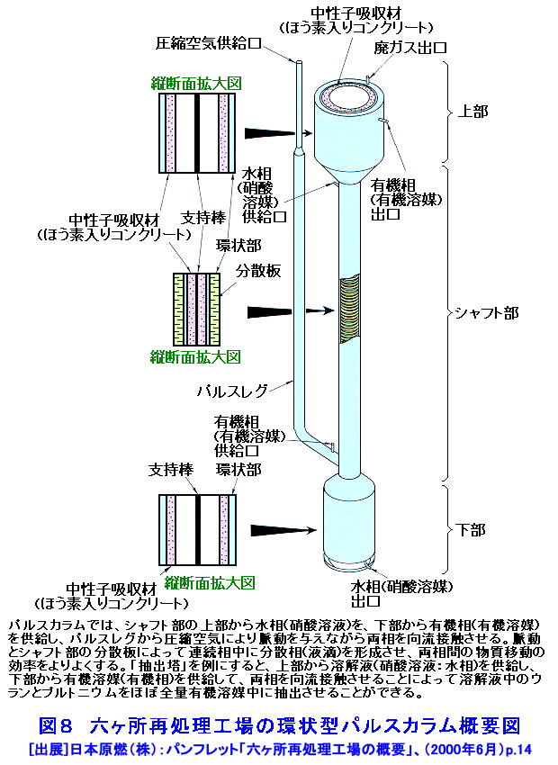
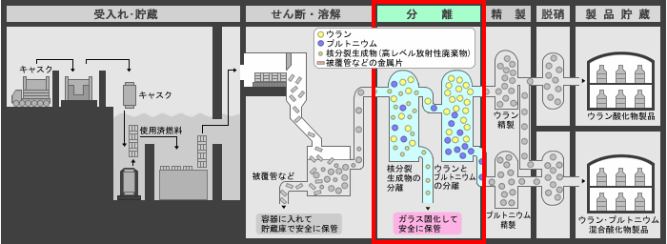
Exercise 6: Criticality Safety of Chemical Process in Pulse column
Material Form | radius (cm) | k-eff
Pu(-0.2) | 27.8 | 1.00095
Pu(-1.0) | 13.4 | 0.99959
PuU (0.72/7.2) | 21.44 | 0.99954
PuU (0.36/7.2) | 28.75 | 1.00049
PuU (0.5/8) | 25.18 | 1.00018
Material : Pu and U in solution
Mass density: Water solution, fix with 1.0g/cc
Pulse Column: Variable Diameter (cm), infinite column
Parameters: Pu density, U-Pu composition
Notes:
Finally we used MCNP for criticality safety in chemical process in pulse column. To reduce the proliferation risk, the Rokkasho Reprocessing Plant adopted the Plutonium-Uranium Co-extraction Technology that combines recovered uranium with separated plutonium before denitration. Through this process, plutonium is recovered as uranium-plutonium mixed oxide (MOX) at the end of the process, so that the plutonium is never recovered on its own. Therefore criticality safety is important to determine the appropriate radius of the pulse column use in this process to prevent the solution achieving criticality. After running the code I found out that depending on the material form and composition the radius ranges from 13.4 to 28.75 cm. In a real plant this is approximately true (around 20 cm radius). This type of calculations are important to ensure safety in this type of plants especially in Japan, a reprocessing country.
(2)

Slide 12
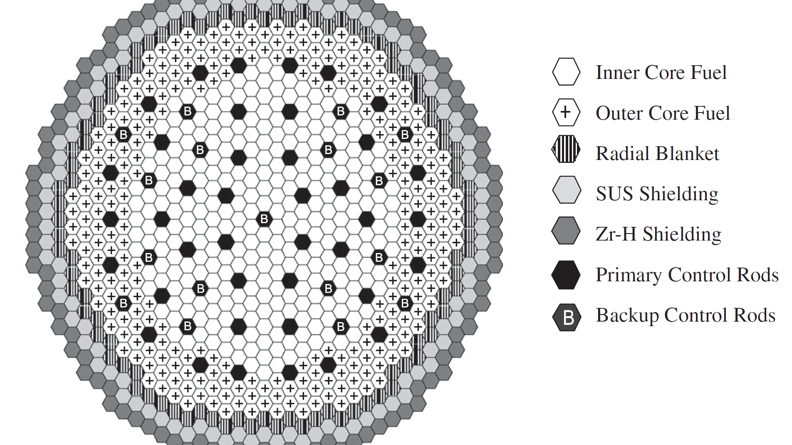
SLAROM-JOINT-CITATION
Nuclear Reactor Core Analysis Code
Notes:
Proliferation of undeclared nuclear material has been an issue ever since nuclear detonation was proven. Therefore, effective proliferation resistance is required and is then important not only for national but also international security. During the nuclear fuel cycle, measures can be taken beforehand in the reactor design phase to prevent attractiveness of various materials, especially plutonium, for use in nuclear explosive devices (NEDs). As we know, when considering FBR, plutonium becomes a concern. While the discharge fuel on FBR core consists of 60-70% fissile isotopes Pu-239 and Pu-231, the remainders are even mass number plutonium isotopes but contrary to this, in the blanket there are larger amounts of Pu-239 and therefore very small amounts of Pu-239. This means that before widely adopting this type of HBR, this proliferation concerns must be address to ensure proliferation resistance through all the nuclear fuel cycle. In the following research I replicated the material barriers approach to enhance proliferation resistance of the system and more specifically of the blanket. By materials barriers I mean more specifically and isotopic barrier using properties like decay heat and spontaneous fission neutron generation rate.
(5)

Slide 13
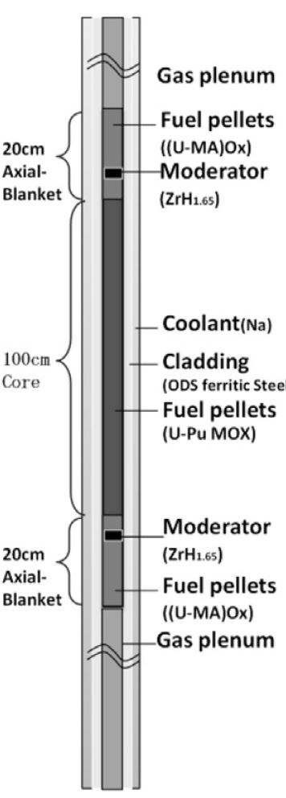
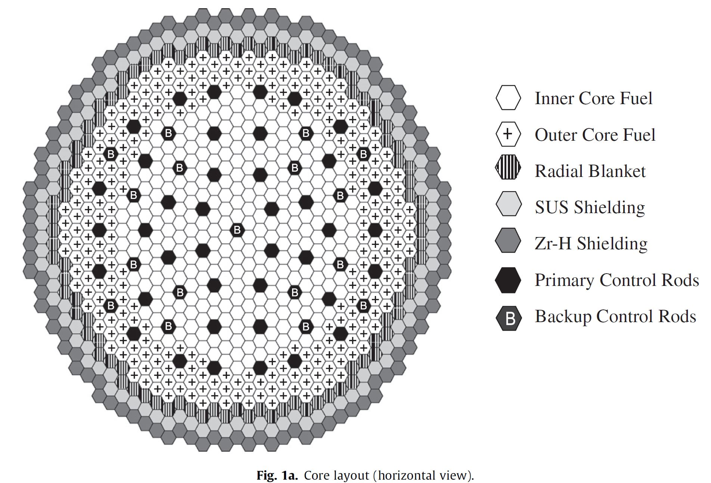
Japan Sodium-cooled Fast Reactor (JSFR)
(Sagara et al., 2005).
Notes:
The core concept used was the high breeding 3530 MWth JSFR. The fuel material is mainly TRUO2-UO2 with inner and outer core enrichment of 18.3 and 20.9 wt..% respectively and U-235 enrichment of 0.2 wt..%. The blanket fuel material in the Reference core is purely UO2 also with 0.2 wt.% enrichment. The axial blanket thickness is the same in the upper and lower region, each 20 cm. The image on the right is the fuel rod design. As you can see the axial blanket is in the some structure as the core therefore they are usually process together at discharge.
(2)

Slide 14
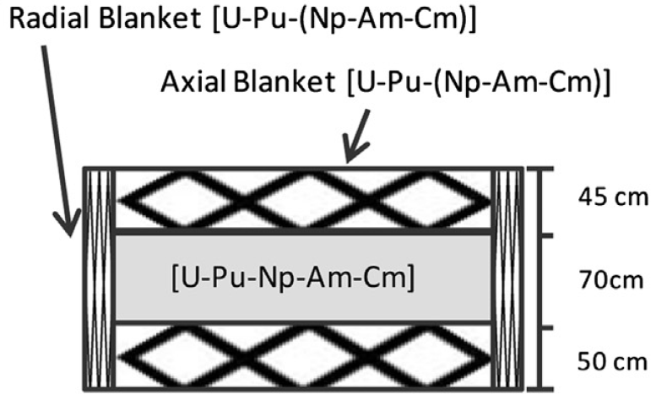
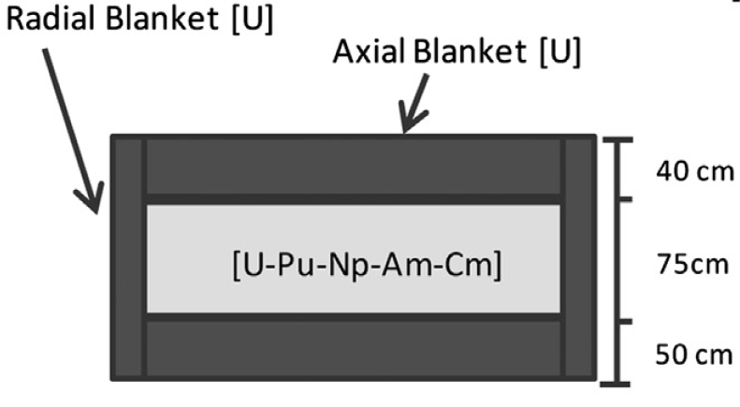
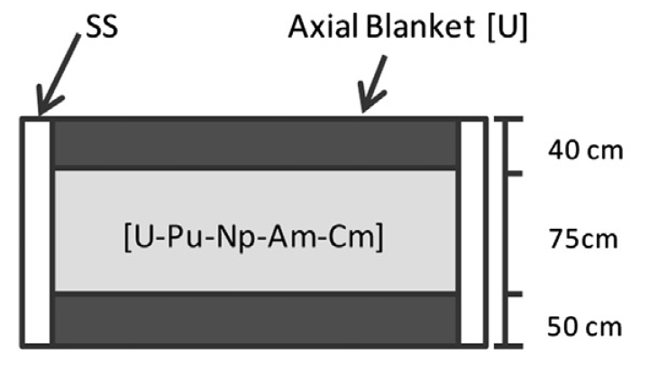
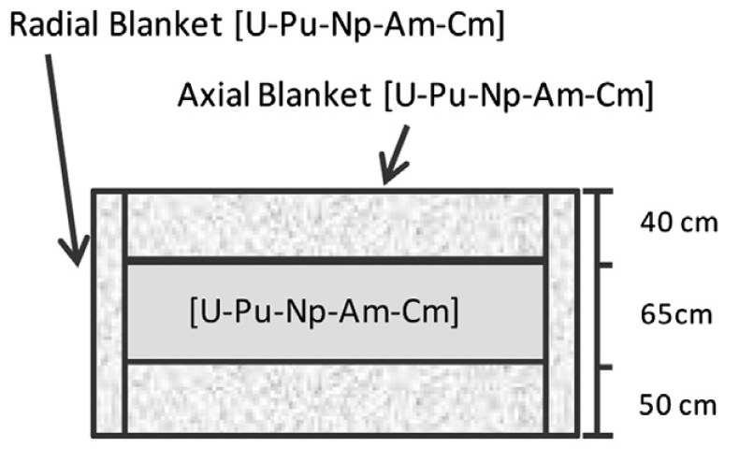
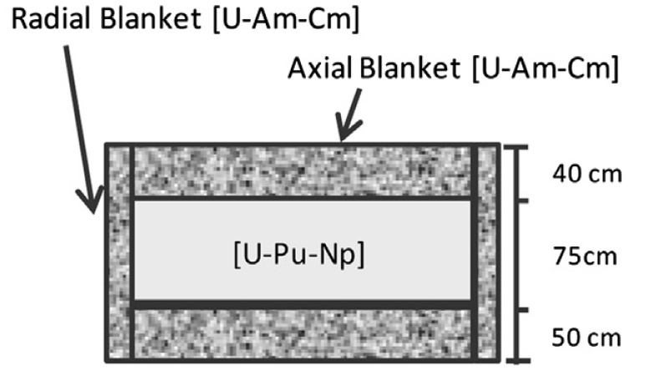
Core design approaches
(Meiliza et al., 2014)
Nuclide | Composition (wt..%)
²³⁸Pu | 1.1
²³⁹Pu | 54.1
²⁴⁰Pu | 32.1
²⁴¹Pu | 4.3
²⁴²Pu | 3.9
²³⁷Np | 0.5
²⁴¹Am | 2.0
²⁴³Am | 1.0
²⁴⁴Cm | 1.0
Notes:
Five core design approaches we’re simulated replicating work done by Sagara, Rie and Saito, Meiliza,. The first is the reference core mentioned previously with a UO2 axial and radial blanket. The second design consists on the reference core but without a radial blanket and replaced for a SS. This is immediately resultant in a less proliferation concern due to fact that the core and the axial blanket are usually reprocess together because of the integrated type core fuel pin. The third core was design to utilize the effect of spontaneous fission neutron generation by pu-240 by loading the blanket with plutonium. The fourth design was using the decay heat of Pu-238 by increasing the MA content in the blanket. And the final design was utilizing the combination of spontaneous fission and decay heat by Pu and MA loading into the blanket. This table gives the composition of the fuel used in this simulations.
(1:35)

Slide 15
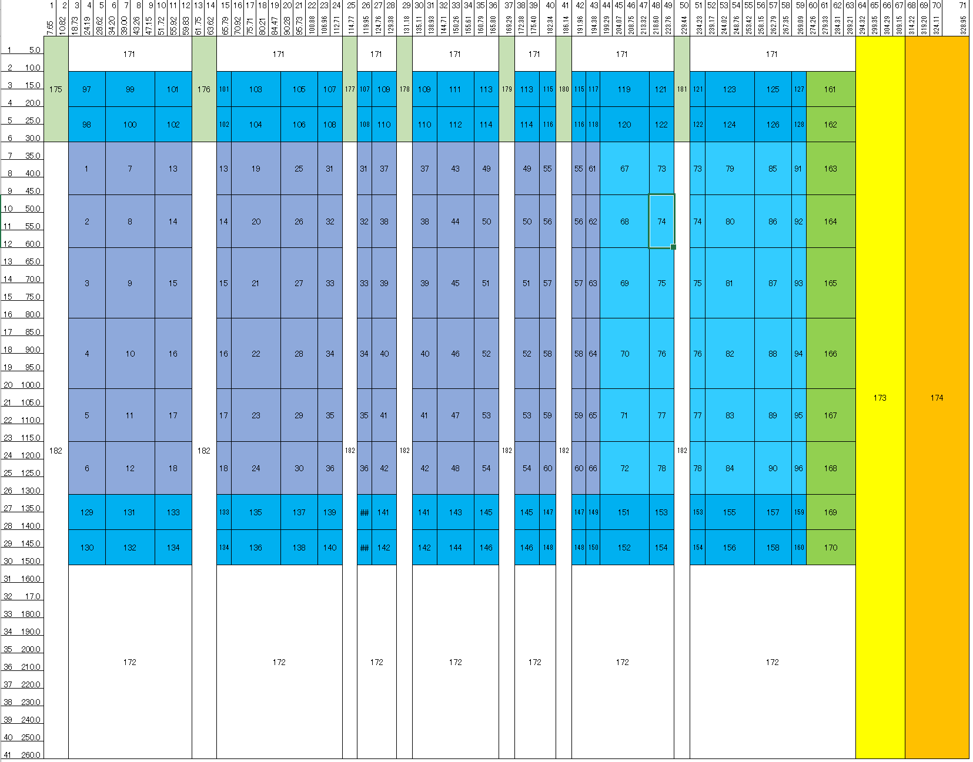
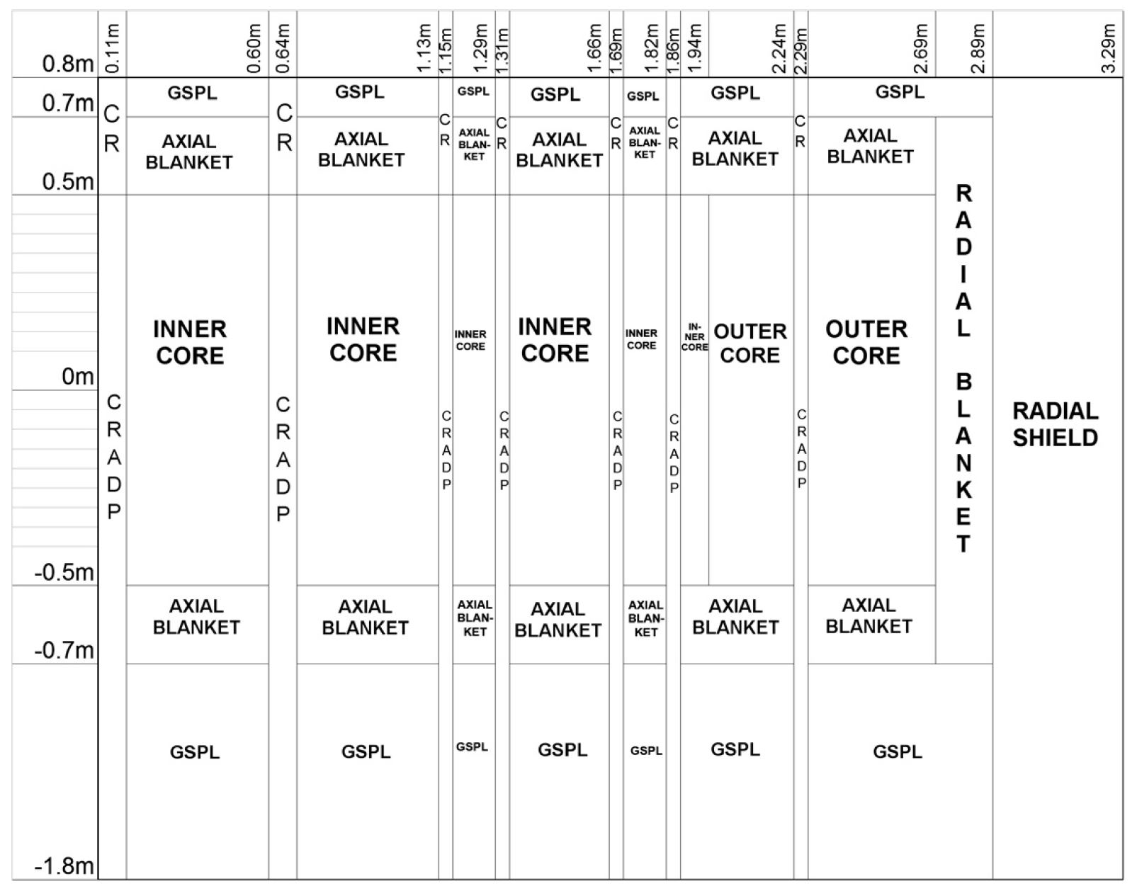
SLAROM-JOINT-CITATION
SLAROM-UF
Cell homogenization calculation
Fast power reactor
Fast critical assembly
Using the Japanese Evaluated Nuclear Data Library (JENDL-3.2)
JOINT-FR
CITATION
Nuclear reactor core analysis code system
Neutron diffusion theory
Two-dimensional RZ diffusion theory
Depletion Chain
Multi-cycle analysis
(Naganuma et al., 2005).
Notes:
The calculations where done using SLAROM which does cell homogenization calculation in fast power reactor and fast critical assembly's using the JENDL, using JOINT FR and using CITATION a nuclear reactor core analysis code system that solves problems using finite difference representation of neutron diffusion theory and the two dimensional RZ diffusion theory taking into account a depletion chain and capable of providing multi-cycle analysis.
(1)

Slide 16
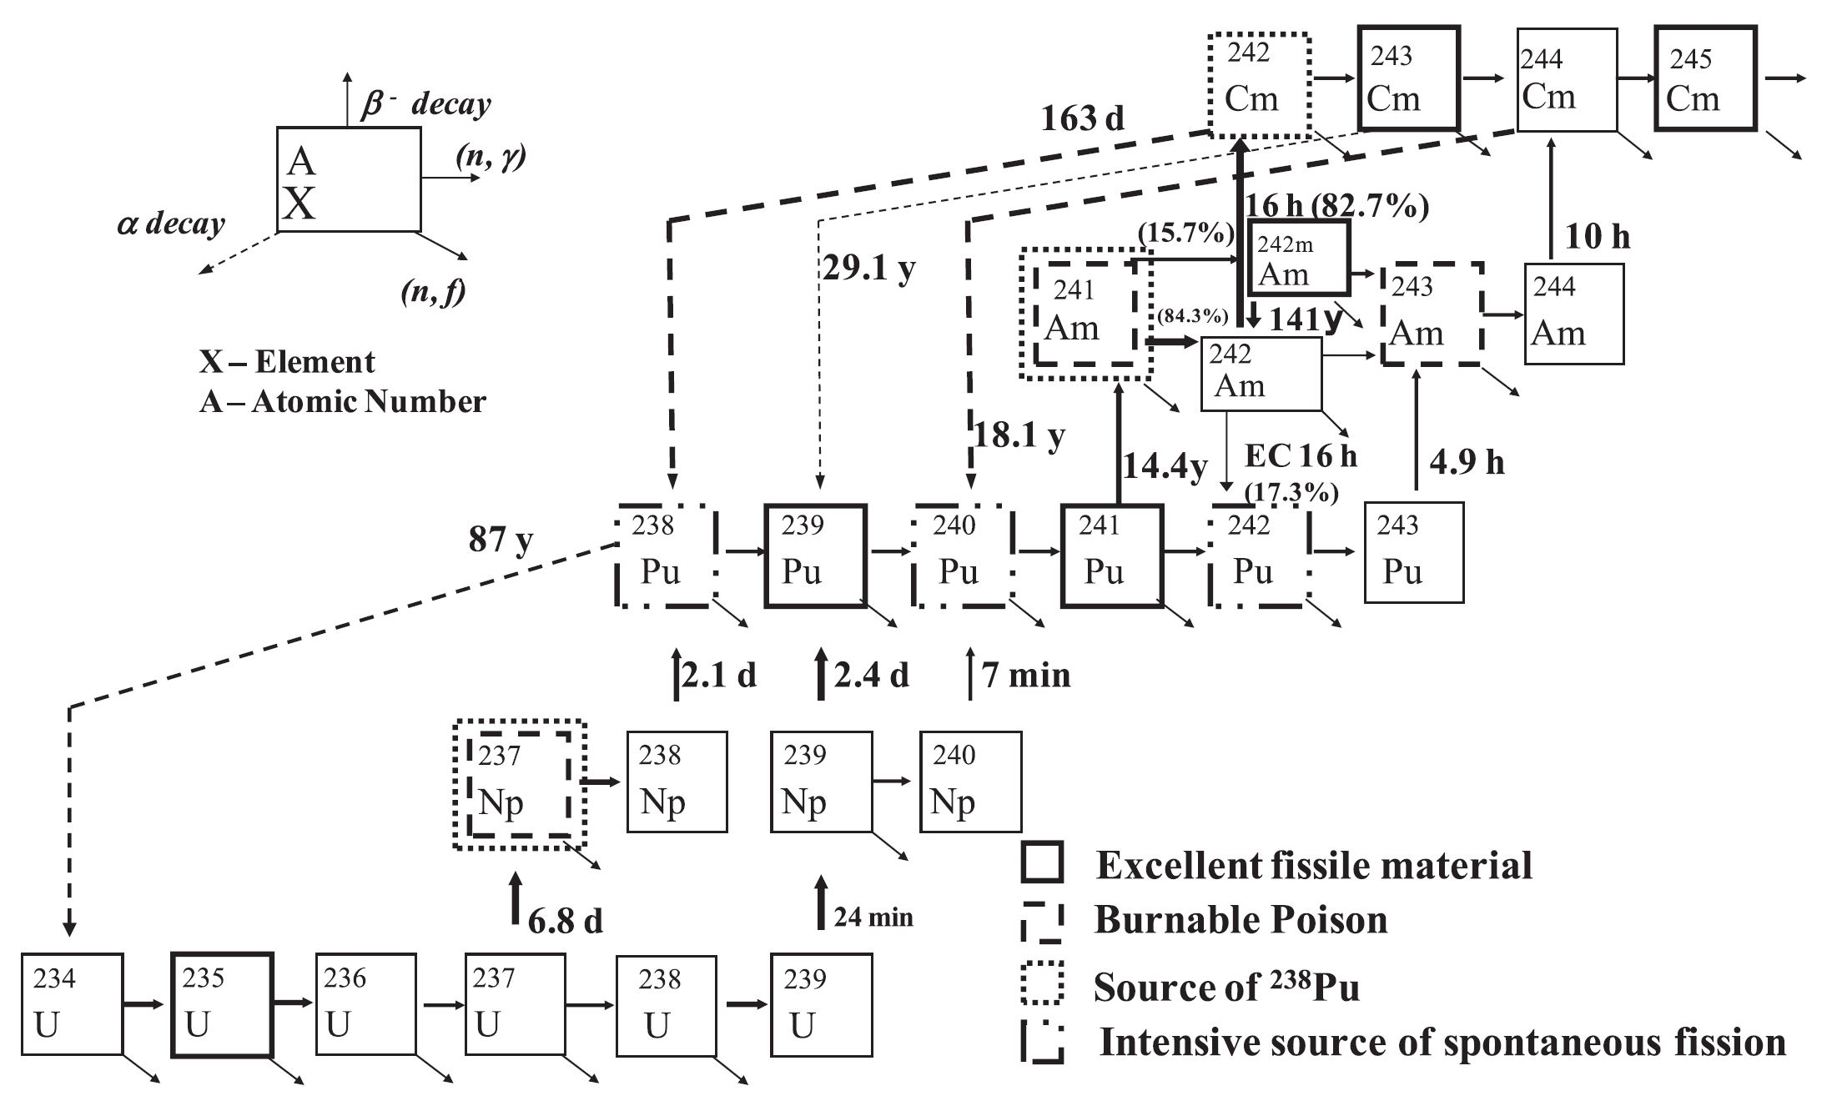
Decay Chain
(Meiliza et al., 2008)
Notes:
It is important to remember why this scenarios are chosen and why this minor actinides.
There are two pathways for producing 238Pu by MA transmutation. One is through β- decay from 238Np (T1/2 =2.36 d), which is produced from 237Np neutron capture reactions, and the other is through alpha decay from 242Cm (T1/2 = 162.79 d), which is the β- decay daughter of 242Am produced from 241Am neutron capture reactions.
Plutonium-242 is produced through β- decay from 242Am (T1/2 = 16 h), which is produced from 241Am neutron capture reactions, and 240Pu are produced through alpha decay from 244Cm (T1/2 = 18.1 y), which is the β- decay daughter of 244Am produced from 243Am neutron capture reactions.
(1)

Slide 17
Pu-239 Isotopic Fraction remains high throughout cycle
Notes:
No matter which one you use, Pu-239 always high.

Slide 18
Spontaneous Fission Rate Strategy (Pu-240)

Slide 19
Decay Heat Isotopic Barrier Strategy (Pu-238)

Slide 20
Initial Reactivity is mostly unchanged
Case | Initial K-eff | Change (%)
REF | 1.0471084 | -
No Blanket | 1.0459388 | 0.11
Pu loading | 1.0539622 | -0.77
MA loading | 1.0463084 | 0.73
PuMA loading | 1.0510942 | -0.46
Case | VRC | Change (%)
REF | 0.00022537 | -
No Blanket | 0.00021632 | -4.02
Pu loading | 0.00023405 | 8.20
MA loading | 0.00022602 | -3.43
PuMA loading | 0.00023156 | 2.45

Slide 21
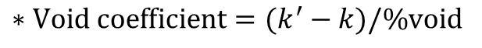
Void Reactivity Coefficient
Case | Mean VRC | Change (%)
REF | 0.00018349 | -
No Blanket | 0.00016701 | -8.98
Pu loading | 0.00019229 | 15.14
MA loading | 0.00018735 | -2.57
PuMA loading | 0.00019091 | 1.90
$$∗Void coefficient=(k^{′}−k)/\%void$$

Slide 22
Specifications and core characteristics
Item | Unit | HBC | Blanket Free | Pu Loading | Am/Cm Loading | Pu/MA Loading
a) Plant
Axial Blanket Thickness (upper/lower) | cm | 20/20 | 20/20 | 20/20 | 20/20 | 20/20
Breeding Ratio |  | 1.12 | 1.04 | 1.07 | 1.09 | 1.08
Transmutation Rate | % | - | - | - | 17.00 | 16.02
Initial Pu Fissile Inventory | [t/GWe] | 9.395 | 9.395 | 10.446 | 9.392 | 10.095
Pu Reduction Ratio |  | -0.0874 | -0.0393 | -0.0565 | -0.1027 | -0.0720
Discharge Burnup
Core | GWd/t | 139.6 | 87.4 | 83.3 | 84.2 | 83.7
Total | GWd/t | 52.0 | 59.2 | 52.0 | 52.0 | 52.0
Void Reactivity Coefficient |  | 1.83E-04 | 1.67E-04 | 0.00E+00 | 1.87E-04 | 1.91E-04
Blanket TRU enrichment | [wt.%] | - | - | 3 | - | 2
Blanket MA fraction | [wt.%] | - | - | - | 5 | 2
Notes:
These are the major specifications and core characteristic obtained. As mentioned previously, all that was changed was the composition therefore leaving the thickness of the blankets unchanged. This was done to analyze the effect of just the composition before changing structural measurements and going into more complex studies.
For the reference core
For the blanket free a breeding ration of 1.04 was obtained,
For the Pu loading case a breeding ratio of 1.07 was obtained but can be increase by modifying the axial blanket and core height (ongoing calculations). There is an increase in pu fissile inventory compare to the REF case.
For the Am/Cm loading case. In this case a breeding ratio of 1.09 was obtained. Modifying core design parameters this can be increase. A transmutation rate of 17% was obtained using 5% MA fraction in the blanket.
In the PuMA case, the last two effects are combined together and a breeding ratio of 1.08 was obtained and a transmutation rate of 16.02% This was done by utilizing a blanket tru enrichment of 2% and blanket MA fraction of 2%
It is important to notice that discharge burnup change which I still dont understand completely.

Slide 23
Isotopic composition in discharged fuel
Notes:
Proliferation resistance measures were the plutonium isotopic fraction. The Categorization done by Kessler (2007) was used stating that more than 9% pu-238 isotopic fraction was sufficient to be regarded as proliferation resistant due to decay heat and radiation. While Mcdonald (2005) stated that at least 18% Pu-240 was also sufficient for proliferation enhancement due to contribution of high spontaneous fission rate.
It can be seen that for the reference core blanket that the UO2 produces high grade plutonium in the range of weapon grade. The discharged fuel while having large quantities of Pu-239 (around 60%) the content of Pu 240 is also high (30%) therefore it can be regarded in the range of MOX-grade plutonium. This blanket compositions raises concerns and the elimination of the radial blanket is a possible solution.
For the next method in the Pu loading case, the blanket can be regarded as reactor-grade plutonium due to the high content of Pu-240. this means that a possible solution is the addition of Pu in the range of 2% to make the blanket proliferation resistance.
In the case of only MA loading the blanket barely meets the proliferation resistance requirements of Pu-238 which means is another option. Similarly for the Pu/MA loading except that the Pu-240 requirement is barely met and not the Pu-238.

Slide 24
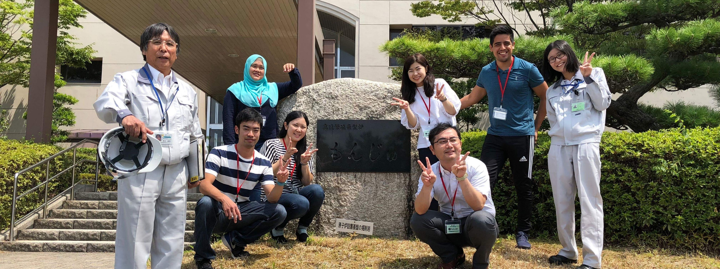
Research Laboratory Visit
Tsuruga, Fukui Prefecture

Slide 25
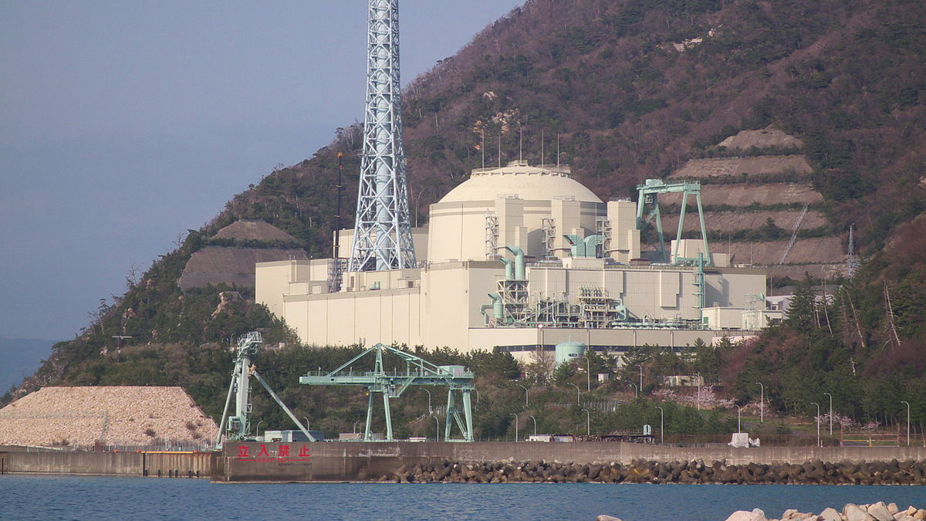
Monju Japanese Sodium-Cooled Fast Reactor
Fukui Prefecture
Notes:
On August 2 we went on a field trip to the Fukui Prefecture to see the monju JSFR.

Slide 26
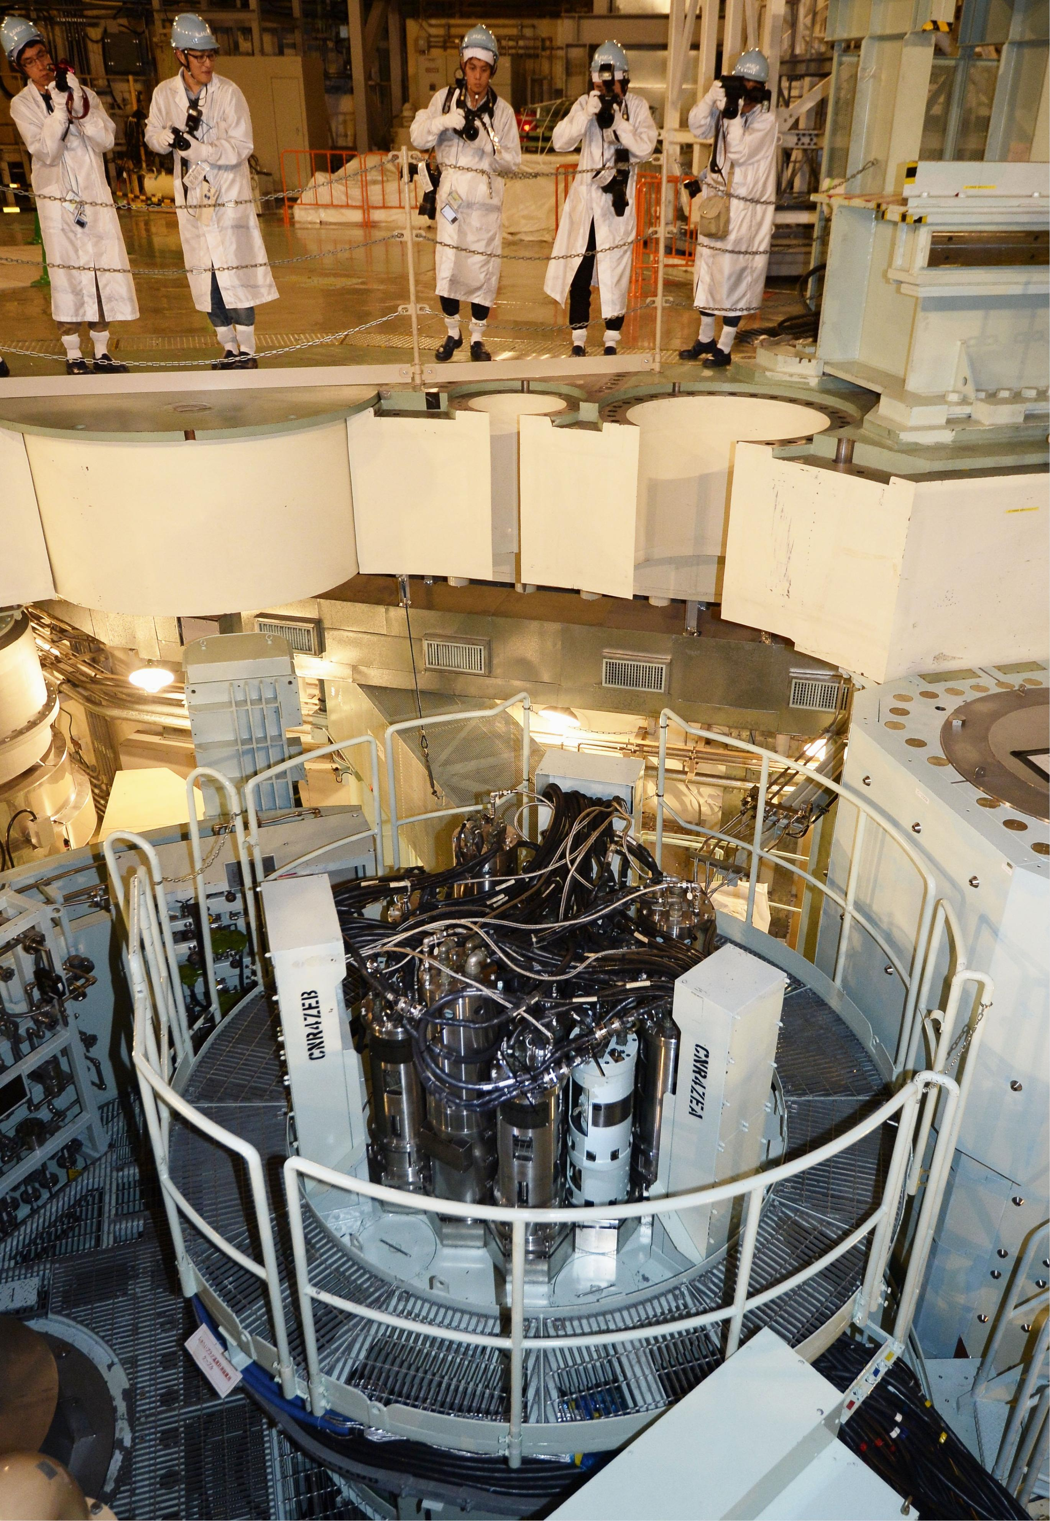
Fast-Spectrum Reactor Characteristics
Sodium Cooled
MOX-fueled
Loop-type
280 MWe and 714 MWt
Breeding ratio of 1.2
Currently undergoing decommissioning process
Notes:
Monju is a sodium cooled, MOX-fueled, loop-type reactor with three primary coolant loops, designed to produce 280 MWe from 714 MWt. It has a breeding ratio of approximately 1.2. This trip was incredible as it allow me to see for the first time as a nuclear engineer a real nuclear reactor and also similar to the one I studied during my research at Tokyo Tech.

Slide 27
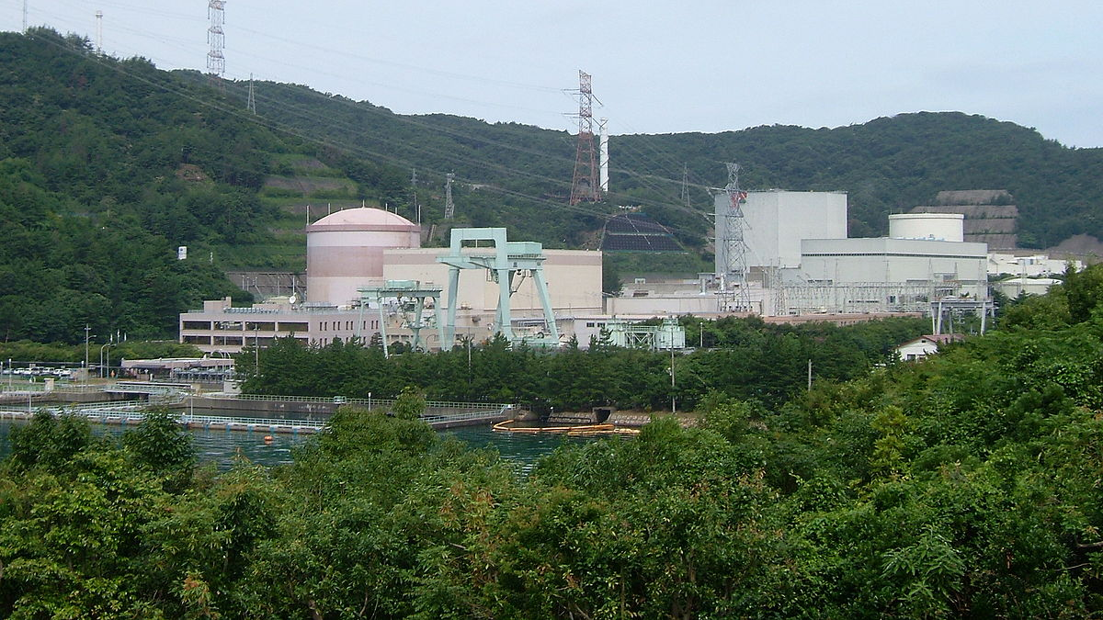
Fugen Advanced Thermal Reactor
Fukui Prefecture

Slide 28
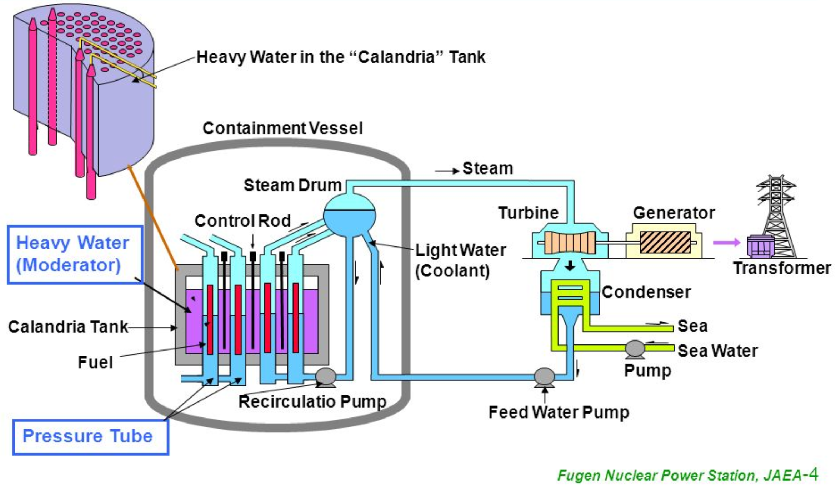
Advanced Thermal Reactor
165 MWe (557 MWt)
Demonstration reactor
Pressure Tube Type Core
Heavy Water Moderator
Boiling Light Water Coolant

Slide 29
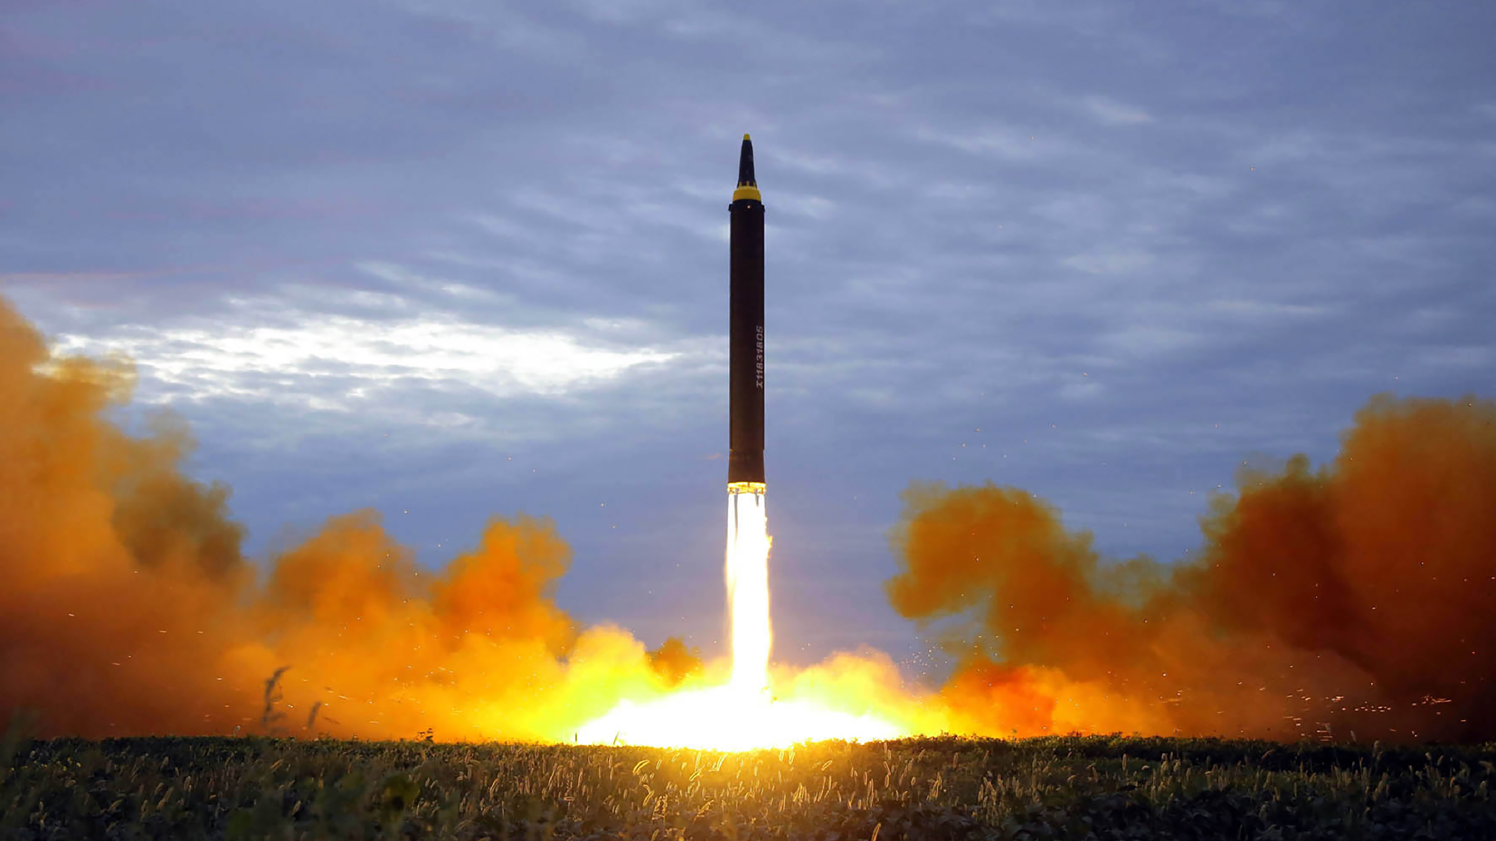
World Politics and Nonproliferation in the Nuclear Age
Notes:
During the summer program not only did I undertake research tasks but I also took the world politics and nonproliferation in the nuclear age course. This course help me understand the fundamentals of nuclear nonproliferation and security through the case studies in world politics and the international community from a variety of speakers including the foreign ministry taro KONO. Some of the topics included the Manhattan project, new nuclear proliferation problems and envisioning the elimination of nuclear weapons among others. It is important for us, nuclear engineers, to understand the potential impact of nuclear technology in politics and nonproliferation and the importance of security and physical protection in todays nuclear related technology systems. Not only is it important to widely accept nuclear energy but it cannot be done with the appropriate assurance that it will be safe to use.

Slide 30
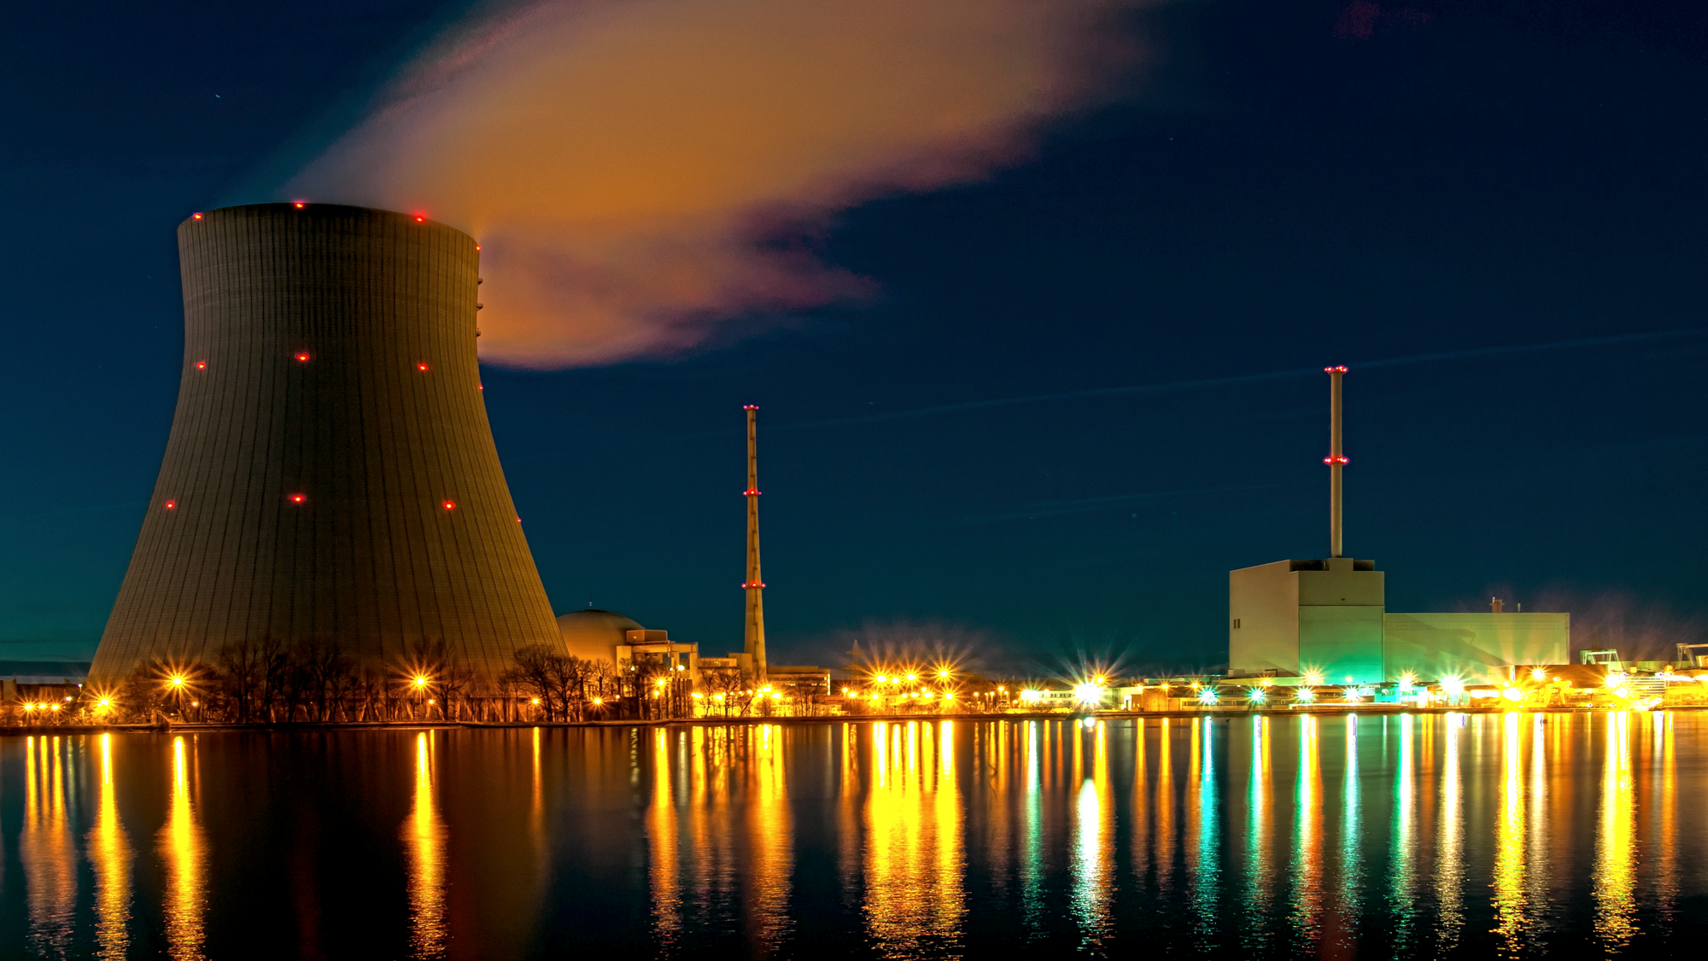
Questions?

Slide 31
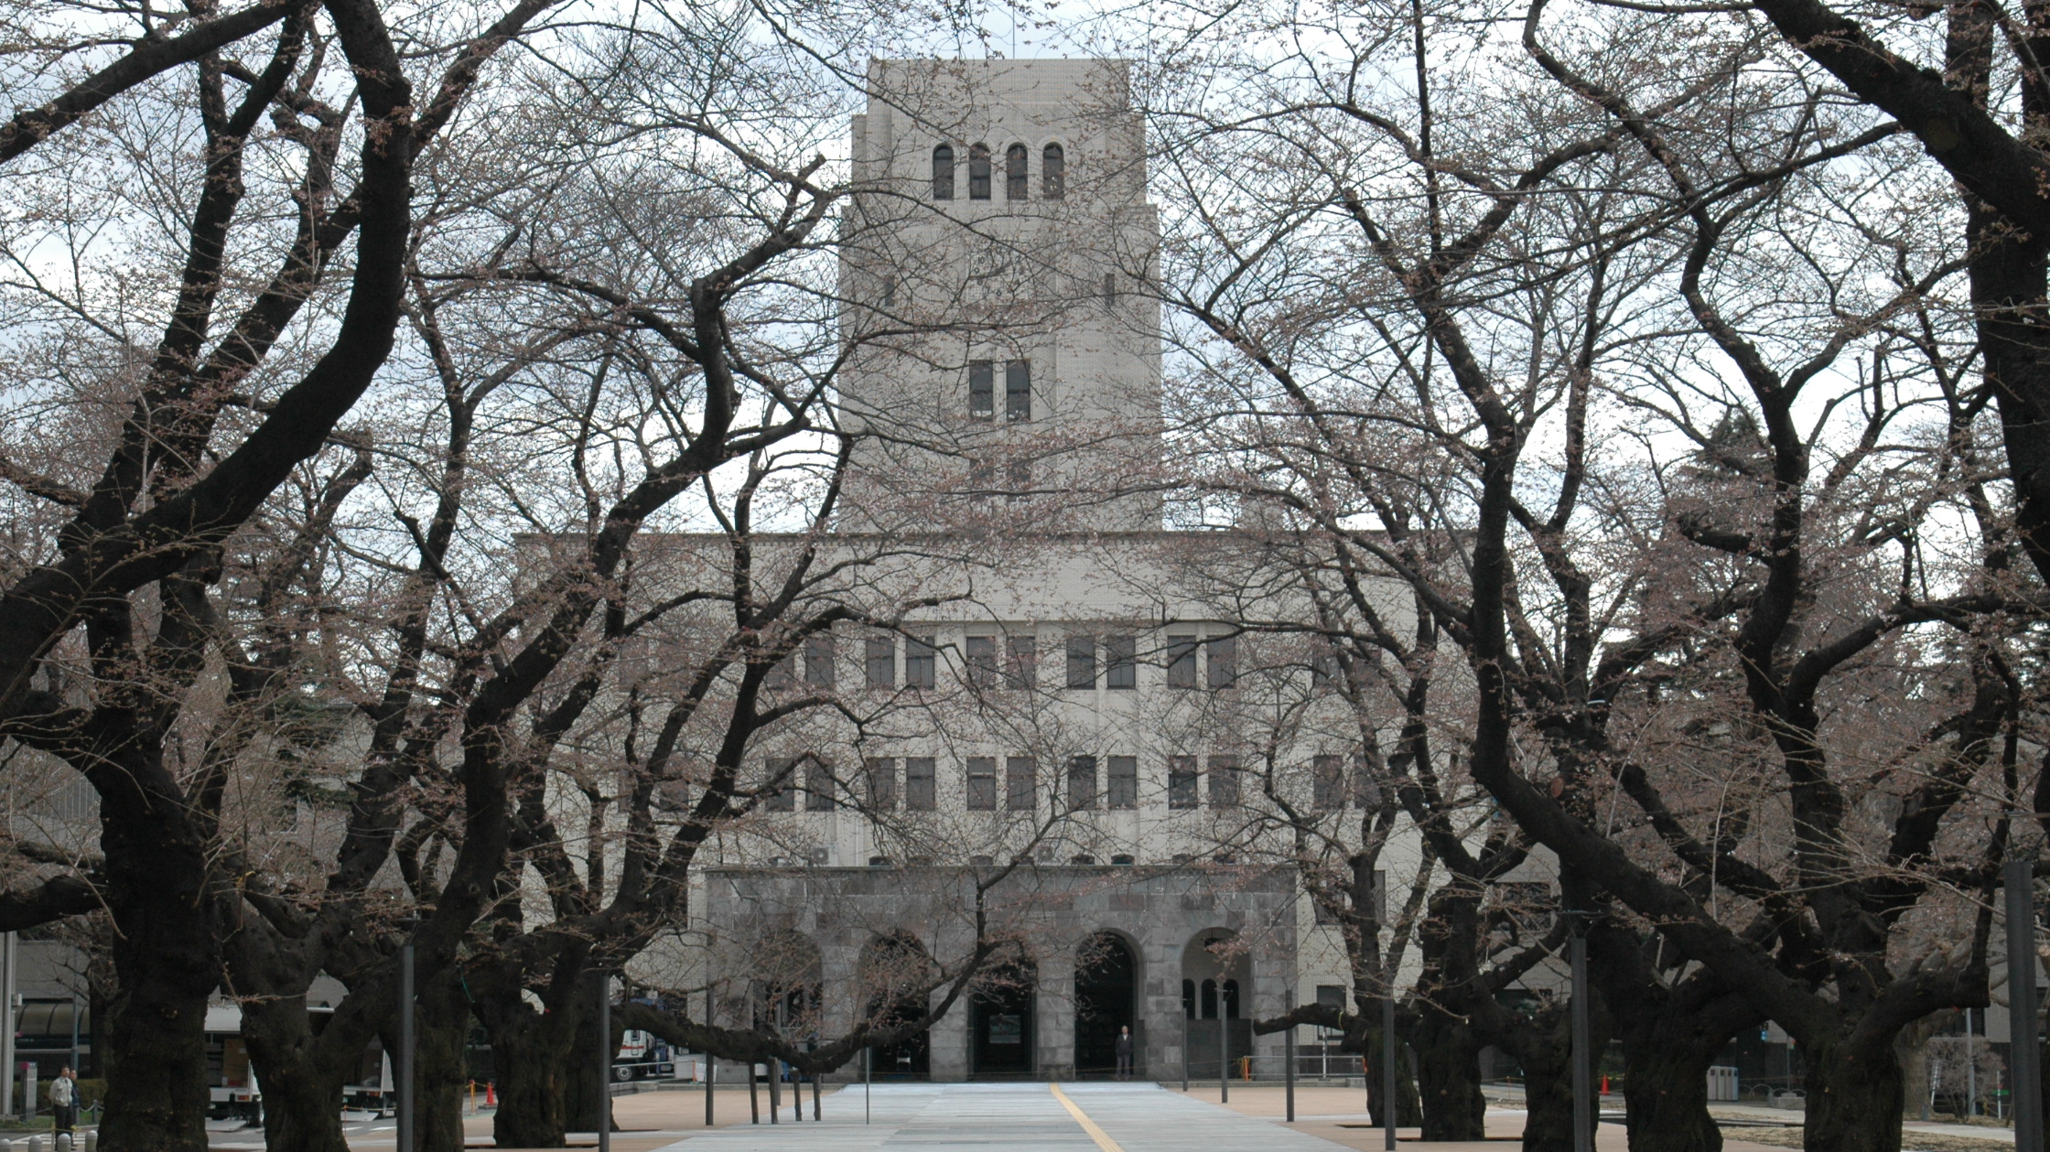
Acknowledgements
Professor Hiroshi SAGARA
Tokyo Tech summer program staff
Laboratory colleagues
Tokyo Institute of Technology
UC Berkeley
Japan Student Services Organization (JASSO)
Notes:
I want to thank SAGARA sensei for allowing to come to his laboratory and teaching me such fundamental knowledge and techniques. I would also like to thank the Tokyo tech summer program staff for all their help. My laboratory colleagues were also we’re pivotal to my learning. I am as well grateful to the Tokyo institute of technology and UC Berkeley and JASSO for their support and making it possible for me to come to this beautiful country and not only acquire technical knowledge but also cultural. Thanks to everybody.

